Slide 1


Smart Attendance System via OpenCV-Python
Submitted by:
Aman Pratap Shee
Atul Kumar Sinha
Pallav Pushparaj
Sankalp
MD Faiz
Pratik Kumar
Mentor
Dilip Maity

Slide 2
Outline :
1. Introduction
2. Algorithm ( flow chart )
3. Functional Block Diagram
4. Results
5. Conclusion
6. Future Work

Slide 3


Introduction :
Traditionally attendance is marked manually by teachers and they must make sure correct attendance is marked for respective student.
This whole process wastes some of lecture time and part of correct information is missed due to fraudulent and proxy cases.

Slide 4
Introduction :
In order to determine classroom attendance, face detection and face recognition are performed. Face detection is used to determine the location of the faces in the classroom image and extract sub images for each face. Then, in face recognition, the face images detected will be compared with the data base consisting of images of students in the class, and attendance will be recorded accordingly.

Slide 5
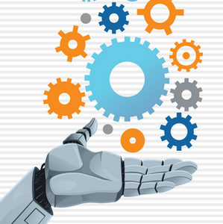


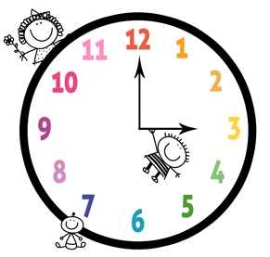
Significance:
1-Automated
2- Economically
3-Effective
4- Keep extra time

Slide 6
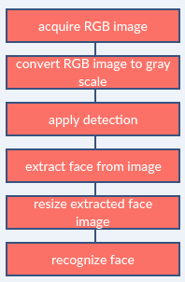
Image processing:

Slide 7
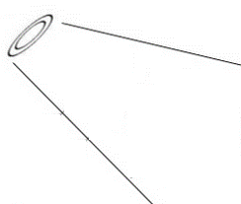
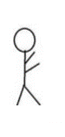
Basic Structure
Student Face
Teacher
Mobile Camera

Slide 8
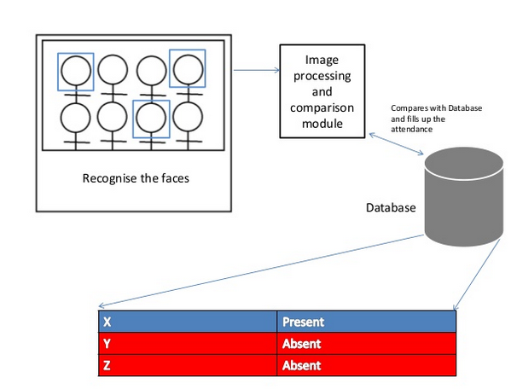

Slide 9
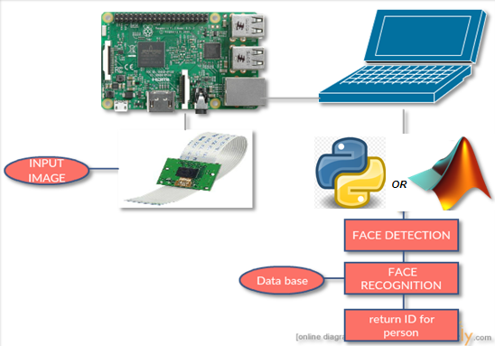
Functional Block Diagram:
The whole system should consist of

Slide 10
Face Detection:
Face detection is a computer technology used to identify human faces in digital images by determining the location of the faces in the image and extract sub images for each face.
Viola Jones algorithm will be implemented to recognize face and non-face patterns and enable us to identify locations of the faces in the image.

Slide 11
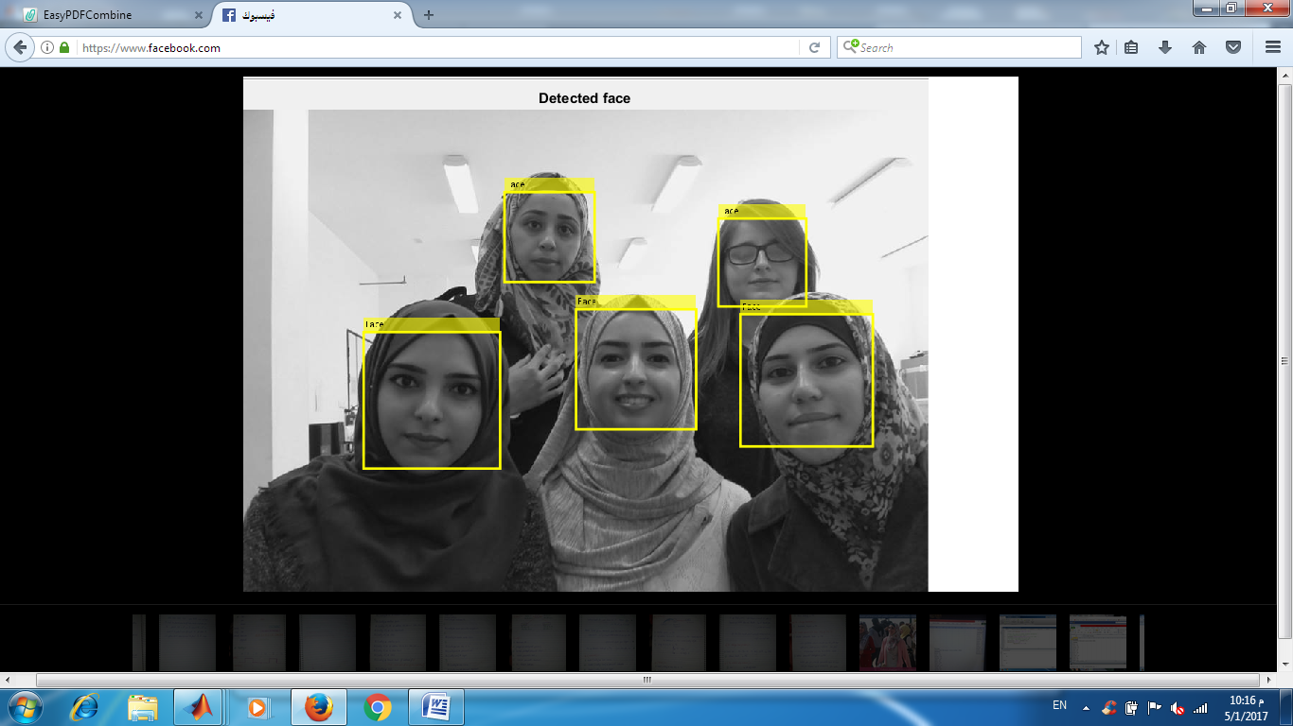
Example for detect face :

Slide 12
How Do We Create Database
Database is the collection of face images and extracted features. And the database includes names of students & registertion number for each student .
We created a data base for 18 persons, were we took 10 images per person using raspberry pi model 2 cam, these images were taken at different times and with variations in illumination, facial expressions, and facial details.

Slide 13
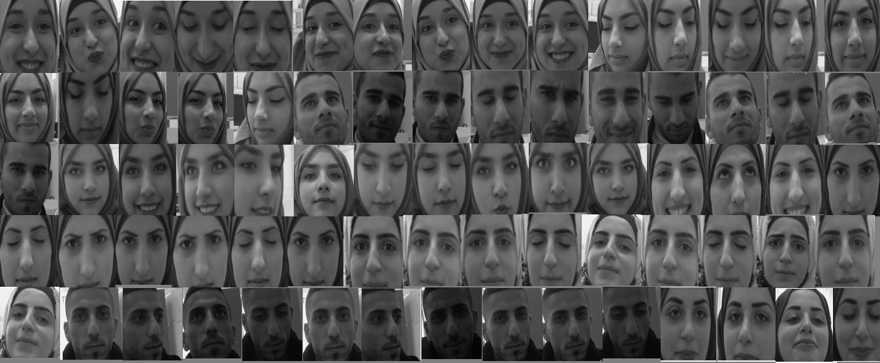
Example for data base images:

Slide 14
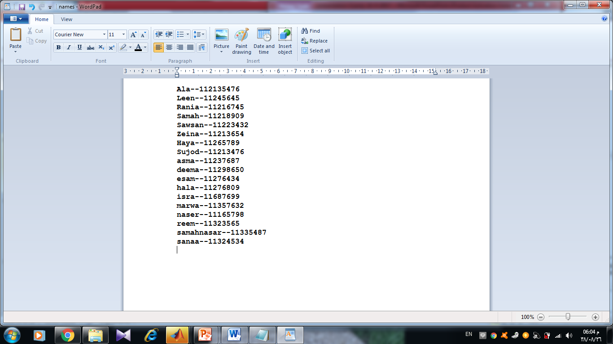
Example: database about the information to students :

Slide 15
EigenFace for Recognition face
1. Create a training set and concatenate columned images into one matrix.
2. Normalize the images and calculate the covariance matrix.
3. Calculate the eigenvalue and the weights for all images.
4. Input an unknown face image.
5. Normalize and calculate weights for input image.
6. Calculate the distance.

Slide 16
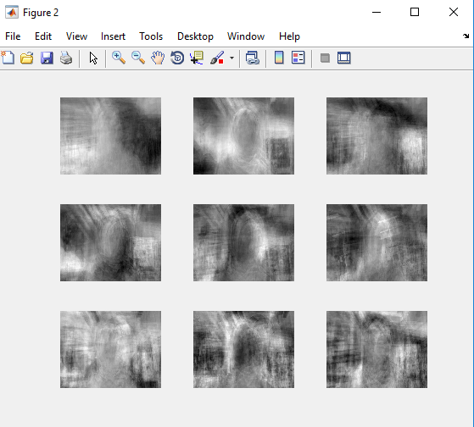
MATLAB Results
Using a matlab code, eigenfaces method is implemented to recognize the faces. We entered the data base for several persons from the data base and got these results
Top 9 Eigenfaces from our Images

Slide 17
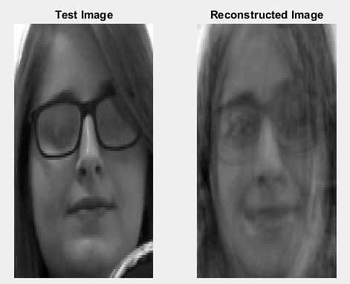
Reconstructed Image from our Images:
We input a new image for the person in class 1 we got this result:
Notes:
When we input the test picture, the code will detect the each face in the picture, crop each face, store the faces in file, recognized each face compare with data base and build reconstructed image for each face as shown

Slide 18
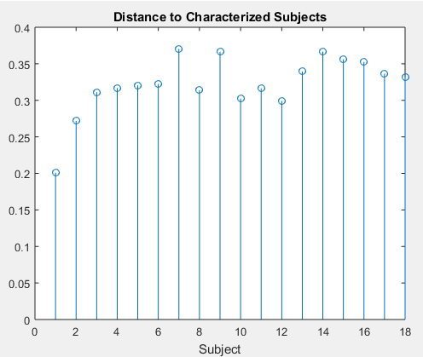
Distance to Characterized Subject for our Images:
We use Mahalanobis distances. The algorithm was able to successfully identify the class that image belonged to, as we can see the input image belonged to class 1.

Slide 19
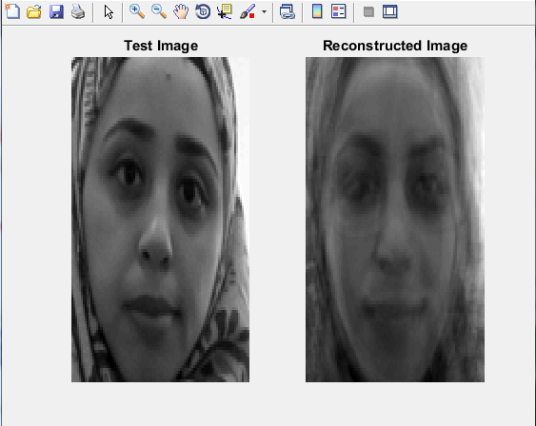
We input a new image for the person in class 4 we got this result:

Slide 20
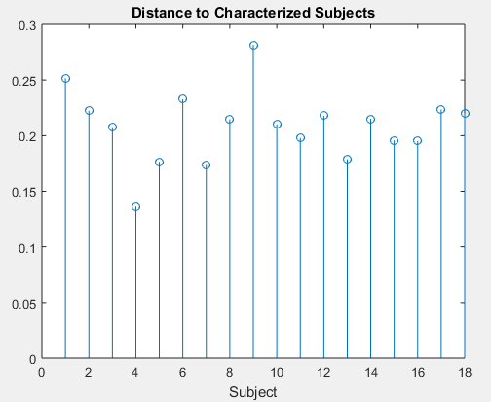
Distance to Characterized Subject for our Images:
We use Mahalanobis distances. The algorithm was able to successfully identify the class that image belonged to, as we can see the input image belonged to class 4.

Slide 21
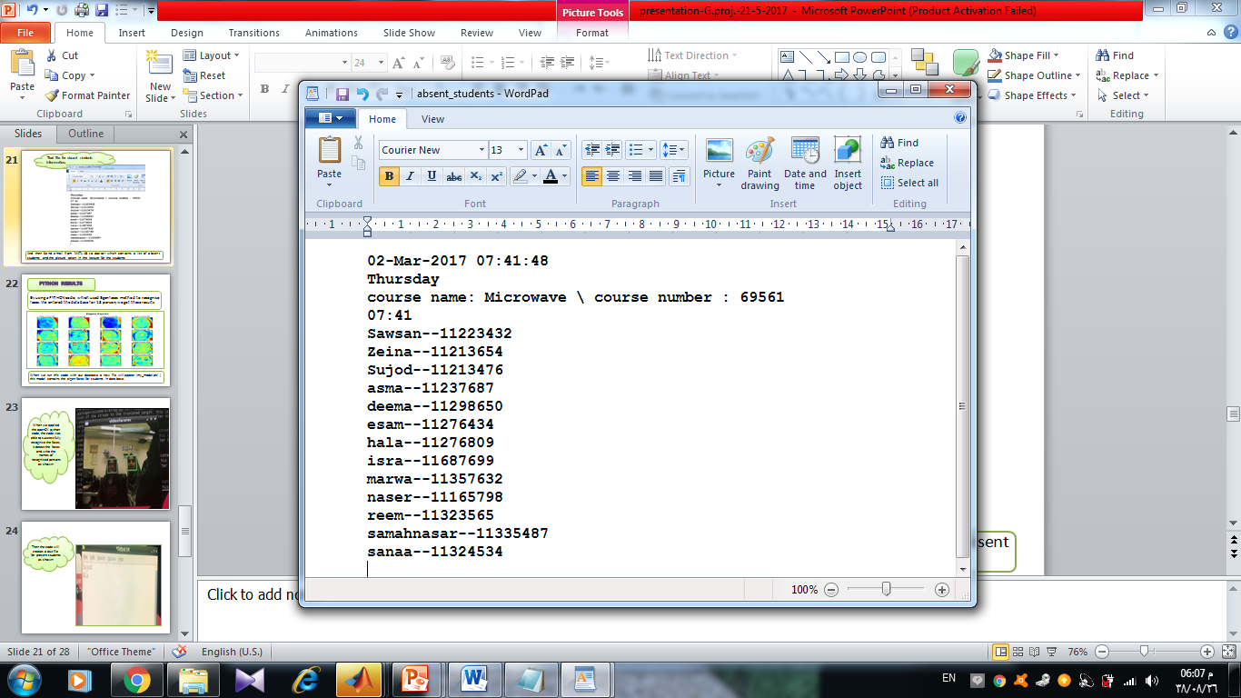
Text file for absent students information:
And then Send email from MATLAB to doctor which contains a list of absent students and the picture taken in the lecture for the students

Slide 22
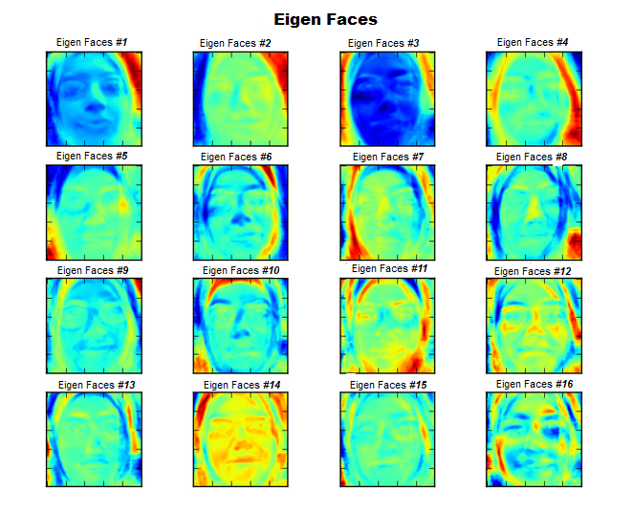
PYTHON Results
By using a PYTHON code, which used Eigenfaces method to recognize faces. We entered the data base for 18 person, we got these results
When we run this code with our database a new file will appear (my_model.pkl) this model contains the eigen faces for students in data base.

Slide 23
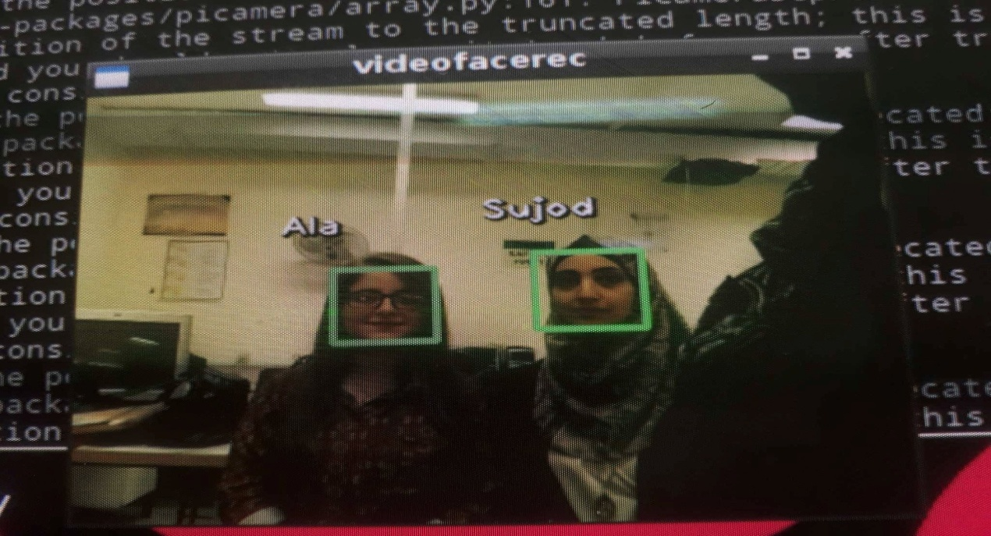
When we applied the openCV python code, the code was able to successfully recognize the faces, it detect the faces and write the names of recognized persons as shown:

Slide 24
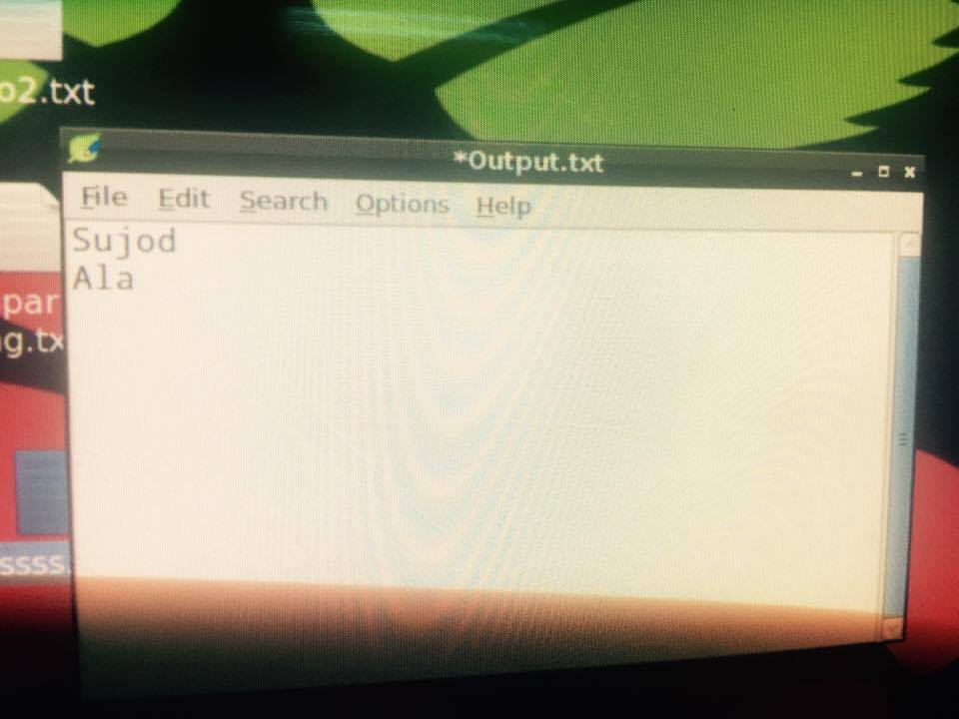
Then the code will creates a text file for present students as shown:

Slide 25
The problem that we faced
In our project we have faced many of problems and we have overcome them:
1- Download Python and library for it on Raspberry Pi.
2- Version of the raspberry pi .

Slide 26
Conclusion:
From our experiment, we noticed the face recognition was sensitive to face background, light, and head orientations. This technique described the accurate and efficient method of automatic attendance in the classroom which could replace the traditional method. An automatic attendance has many advantages, most of the existing systems are time consuming and require semi manual interference from lecturers, our system seeks to solve these issues by using face recognition in the process to save the time and labor. And No need for installing complex hardware for taking the attendance in classroom, all we need is a camera and laptop. We used algorithms that can detect and recognize faces in the image.

Slide 27
Future work
Automatic attendance system can be improved by increasing the number of features which can be extracted to increase accuracy of face recognition. Once the software is developed and tested properly, it could be improved to cover full institutions such as the faculty of engineering.

Slide 28
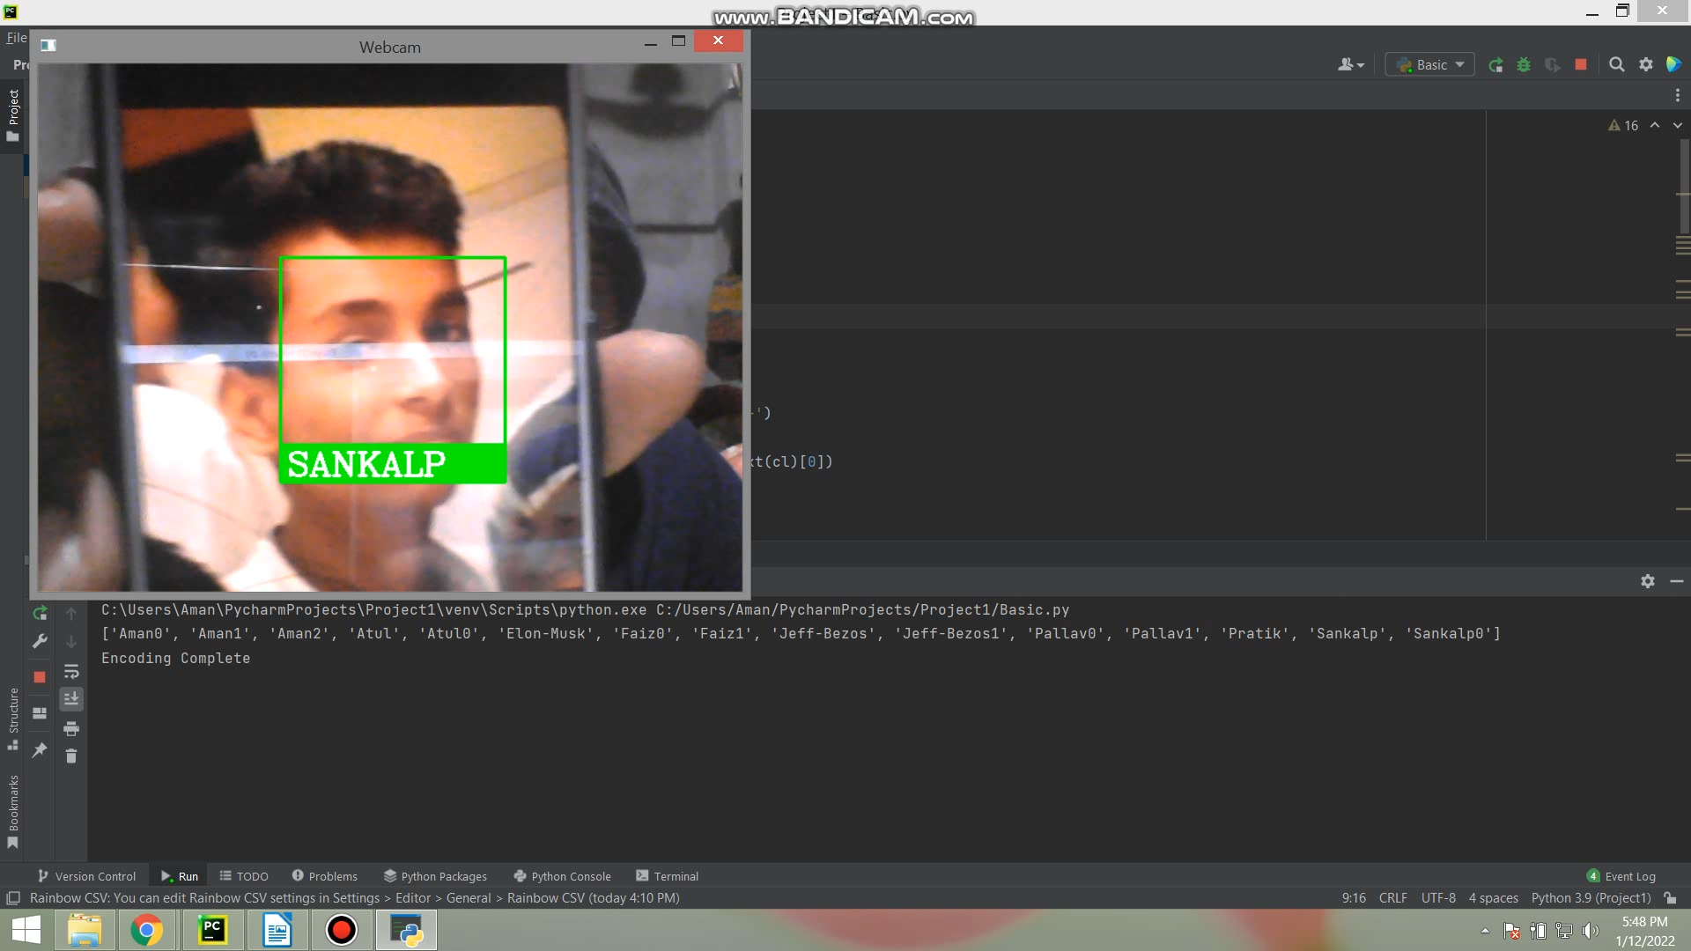
Our Sample

Slide 29
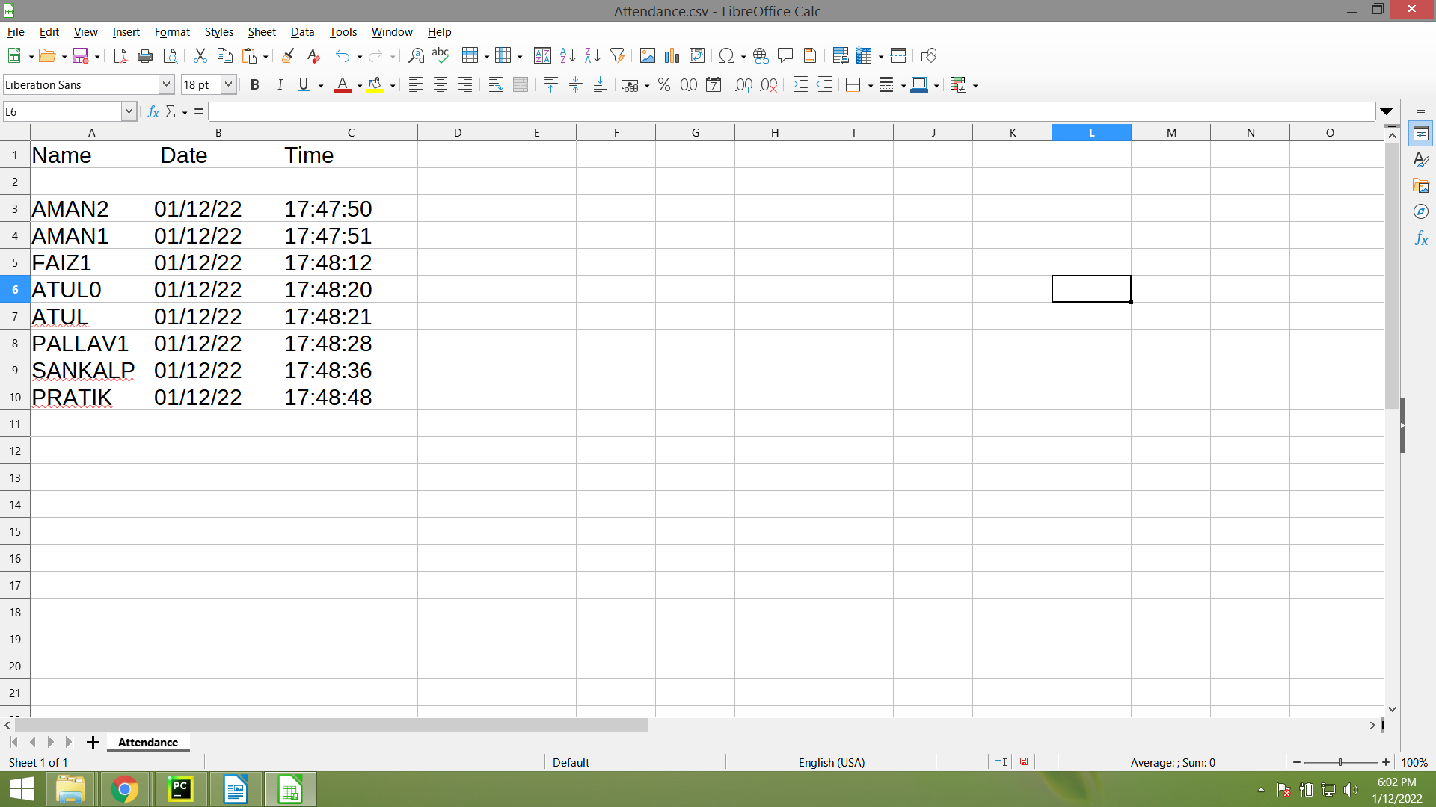

Slide 30


